Slide 1

Single station absolute TEC estimation
based solely on dual frequency GNSS
phase observables
Ivanov A.K., Medvedev A.I., Varzar L.S, Pavlov I.A., Padokhin A.M., Kurbatov G.A.

Slide 2
Introduction
Reliable ionospheric information plays crucial role in many practical applications, including RW propagation,
remote sensing, positioning, communications.
Total electron content (TEC) – one of simple and commonly used ionospheric parameters
can be estimated from GNSS data.
Several approaches to absolute vertical TEC estimation form GNSS data:
1) Global Ionospheric Mapping [IGS and its associated centers]
2) Regional Ionospheric Mapping [US TEC, GA Australia, Roshydromet Russia]
3) Single station solutions
Current single station solutions use both dual frequency phase and code measurements, latter known for its
significant noise, and require satellite and receiver DCB estimation.
Examples of single station solutions:
thin shell and Taylor expansion in geographic coords, ISTP (TayAbsTEC , Yasyukevich, Mylnikova)
thin shell and Fourier expansion in LT and polynomial expansion in latitude, WD IZMIRAN (Shagimuratov)
Present work suggests new algorithm for single station solution
that avoids noisy code measurements and DCB estimation…

Slide 3
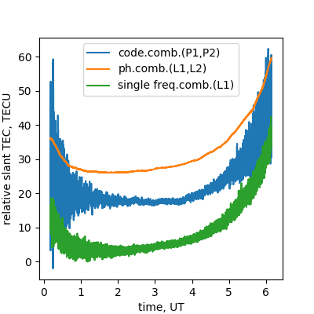
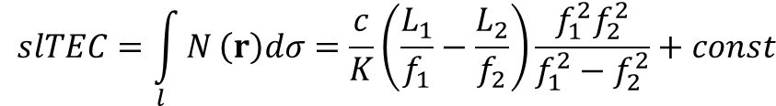
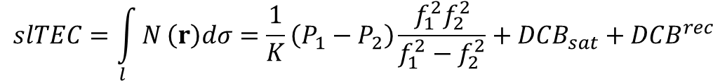
Phase and code measurements of slant TEC
phase measurements
code measurements
$$slTEC=\int_{l}{N}\left(r\right)dσ=\frac{c}{K}\left(\frac{L_{1}}{f_{1}}−\frac{L_{2}}{f_{2}}\right)\frac{f_{1}^{2}f_{2}^{2}}{f_{1}^{2}−f_{2}^{2}}+const$$
$$slTEC=\int_{l}{N}\left(r\right)dσ=\frac{1}{K}\left(P_{1}−P_{2}\right)\frac{f_{1}^{2}f_{2}^{2}}{f_{1}^{2}−f_{2}^{2}}+{DCB}_{sat}+{DCB}^{rec}$$
- rather noisy
- biased by unknown satellite’s and receivers DCBs
- DCBs are assumed stable at a day scale
- actually DCBs at least for receivers can have
significant intraday variability
- very precise
- biased by unknown initial phase
- bias is stable along continuous arch
Typical strategy – code-phase leveling or phase-code smoothing
despite all provides biased slTEC
possibly introducing additional errors and noise
only benefit – longer continuous intervals compared to phase data
further when constructing GIMs requires arbitrary (perhaps non physical)
assumption of zero mean DCB for each constellation
True heroes always take a detour…
- by any means try to use data less contaminated by noise (phase)
- as long as you can avoid procedures that increase noise figure
- avoid imposing non-physical constraints (zero mean DCB)
- reformulate problem to exclude unknown biases (source of error redistribution)
Better to light a candle
than to curse the darkness

Slide 4



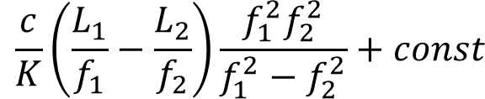
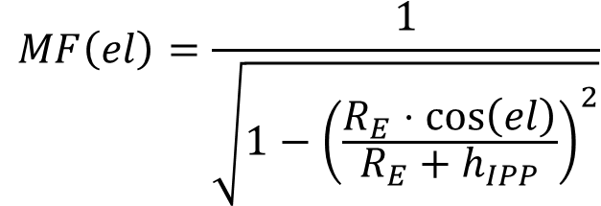
Suggesting algorithm
Key assumptions:
- thin shell approximation
- vertical TEC within thin shell can be approximated in the vicinity of station as
a truncated Taylor (polynomial) expansion
- slant/vertical TEC conversion via SLM mapping function
- all measurements are considered independent
Measurement model
$$slTEC=MF\left(el\right)⋅vTEC$$
$$MF\left(el\right)=\frac{1}{\sqrt{1−{\left(\frac{R_{E}⋅cos\left(el\right)}{R_{E}+h_{IPP}}\right)}^{2}}}$$
$$slTEC=MF\left(el\right)⋅vTEC$$
$$\frac{c}{K}\left(\frac{L_{1}}{f_{1}}−\frac{L_{2}}{f_{2}}\right)\frac{f_{1}^{2}f_{2}^{2}}{f_{1}^{2}−f_{2}^{2}}+const$$
Solve for {a}
$$rslTEC$$
$$vTEC=a_{0}+a_{1}dθ+a_{2}{\left(dθ\right)}^{2}+a_{3}dφ+a_{4}{\left(dφ\right)}^{2}+a_{5}dt+a_{6}{\left(dt\right)}^{2}+a_{7}dθdφ+a_{8}dtdφ+a_{9}dtdθ$$

Slide 5
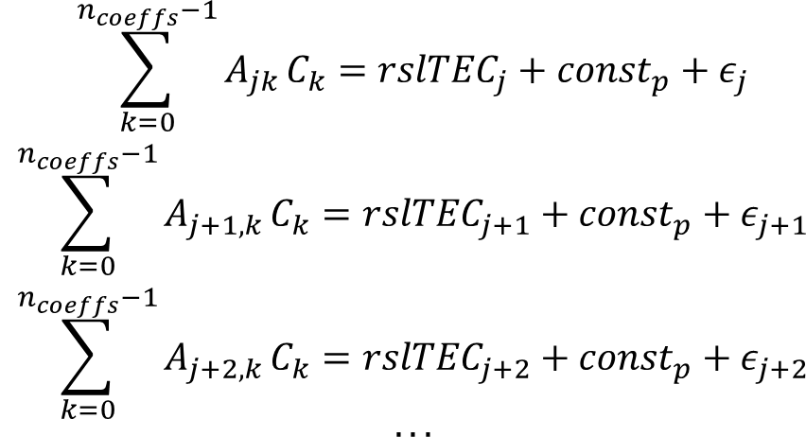

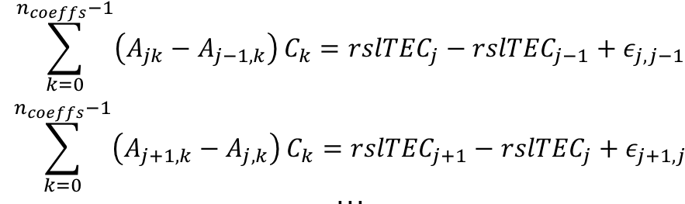
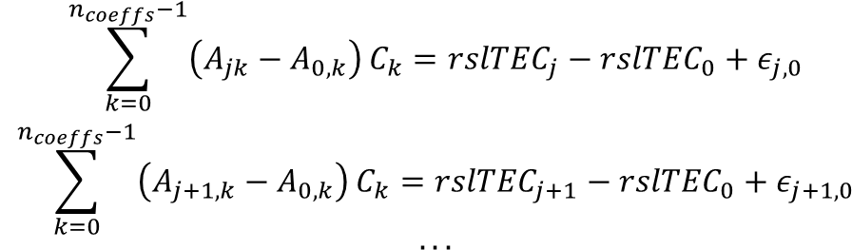
Excluding biases (phase ambiguities)
$$\begin{matrix}\sum_{k=0}^{n_{coeffs}−1}{A_{jk}}C_{k}={rslTEC}_{j}+{const}_{p}+ε_{j} \\ \sum_{k=0}^{n_{coeffs}−1}{A_{j+1,k}}C_{k}={rslTEC}_{j+1}+{const}_{p}+ε_{j+1} \\ \sum_{k=0}^{n_{coeffs}−1}{A_{j+2,k}}C_{k}={rslTEC}_{j+2}+{const}_{p}+ε_{j+2} \\ ...\end{matrix}$$
j-th ray
relative slant TEC (or φ)
(j+1)-th ray
(j+2)-th ray
p-th continuous arch (interval)
time
$$\begin{matrix}\sum_{k=0}^{n_{coeffs}−1}{\left(A_{jk}−A_{0,k}\right)}C_{k}={rslTEC}_{j}−{rslTEC}_{0}+ε_{j,0} \\ \sum_{k=0}^{n_{coeffs}−1}{\left(A_{j+1,k}−A_{0,k}\right)}C_{k}={rslTEC}_{j+1}−{rslTEC}_{0}+ε_{j+1,0} \\ ...\end{matrix}$$
$$\begin{matrix}\sum_{k=0}^{n_{coeffs}−1}{\left(A_{jk}−A_{j−1,k}\right)}C_{k}={rslTEC}_{j}−{rslTEC}_{j−1}+ε_{j,j−1} \\ \sum_{k=0}^{n_{coeffs}−1}{\left(A_{j+1,k}−A_{j,k}\right)}C_{k}={rslTEC}_{j+1}−{rslTEC}_{j}+ε_{j+1,j} \\ ...\end{matrix}$$
“relative” variant
“derivative” variant
$$\tilde{A}⋅C=r+ν$$
[Andreeva et al., 1992; Hernandez-Pajares et al., 1999]

Slide 6
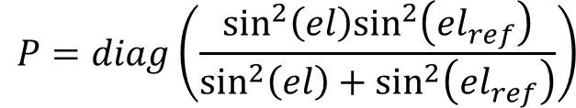







Least squares model fit
$$\tilde{A}⋅C=r+ν$$
$$\tilde{A}⋅\left(C_{0}+c\right)=r+ν$$
$$ν=\tilde{A}⋅c−\left(r−\tilde{A}⋅C_{0}\right)=\tilde{A}⋅c−l$$
C₀ could be zero
$$P=σ_{0}^{2}Ω^{−1}$$
- weight matrix, σ₀ standard deviation of unit weight (for ex. For observation in zenith) Ω covariance matrix of observation errors
$$ν^{T}Pν→min:$$
$$\left(\tilde{A^{T}}P\tilde{A}\right)c−\tilde{A^{T}}Pl=0$$
gives normal equations system
$$Nc=b$$
$$P=diag\left(\frac{\sin^{2}\left(el\right)\sin^{2}\left({el}_{ref}\right)}{\sin^{2}\left(el\right)+\sin^{2}\left({el}_{ref}\right)}\right)$$
works but not very good choice though, off diagonal elements should be present
Additionally positivity constraints on vertical TEC are imposed (vTEC >0)

Slide 7
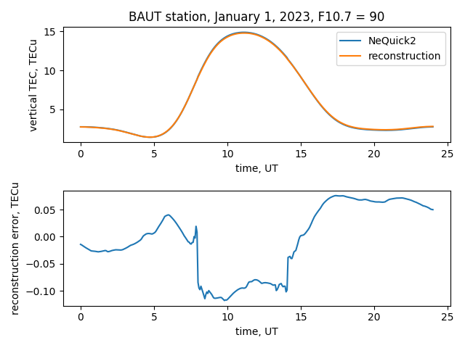
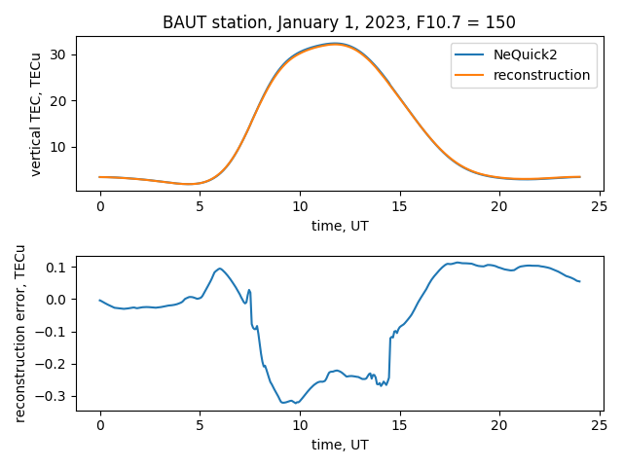
Algorithm validation
1) Use real geometry and data properties (noise, LOL, availability) for arbitrary GNSS station
2) Synthesize phase measurements according to real geometry and data properties from NeQuick2 model
3) Compare modeled and reconstructed vertical TEC

Slide 8
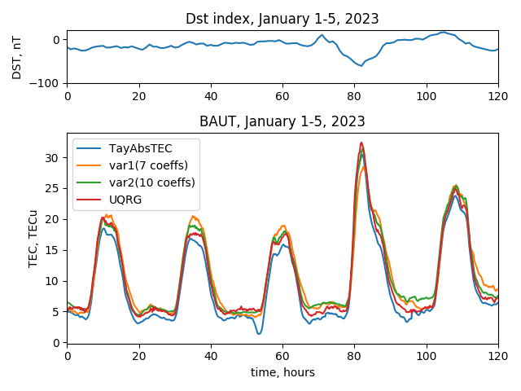
Real world example – GM Storm January 4, 2023

Slide 9
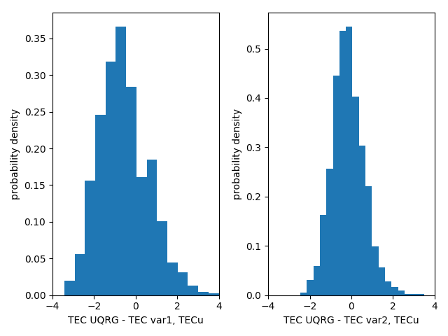
Statistics
One year statistic for middle-latitude station

Slide 10
Conclusions
Method for absolute vertical TEC and derivatives estimation for GNSS Single Station TEC suggested comprising:
phase difference approach to input data – precise dual frequency phase measurements
thin shell approximation and truncated Taylor expansion in the vicinity of station
Inequality constrained least squares estimator
The method allows to use only very precise dual-frequency phase observable
and use physical condition for TEC positivity
No need for DCBs estimation (both satellites and receivers), simple expansion for systems other than GPS
Test with NeQuick2 model provide error estimates <0.5TECu for different locations and space weather conditions
Inter-method differences with GIM products and TayAbsTEC are within 1 TECu on average, up to 3.5 TECu in maximum difference
Possibilities for algorithm application:
Single station solution
vTEC for local empirical model corrections
Global Ionospheric Mapping with additional spatial interpolation (e.g. ordinal krigging)

