Slide 1
Extreme-value magnetic events on the territory of Russia derived from ground-based observations during the 24th solar cycle
Kudin Dmitry, Krasnoperov Roman
Geophysical Center RAS

Slide 2
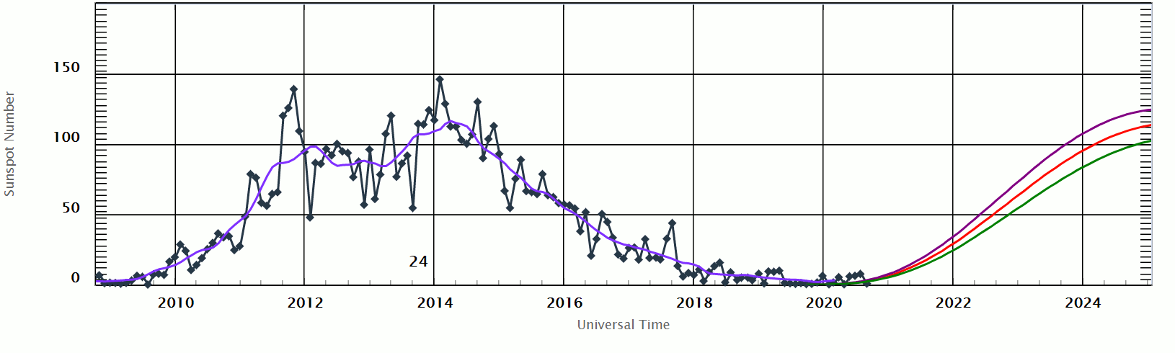
Solar Cycle 24

Slide 3
Geomagnetic observatories and stations data
IAGA-код | Name | Data source | Availability | Geod. coordinates | Mag. coordinates | Country
TIK | Tixie | AARI | 2007-2019 | 71.587 N, 128.921 E | 66.39 N, -161.65 E | Russia
AMD | Anderma | AARI | 2007-2019 | 69.604 N, 60.208 E | 65.63 N, 136.62.E | Russia
PBK | Pevek | AARI | 2007-2019 | 70.080 N, 170.900 E | 65.53 N, -129.03 E | Russia
BOX | Borok | INTERMAGNET,GCRAS | 2006-2020 | 58.07 N, 38.23 E | 54.39 N, 113.08 E | Russia
MGD | Magadan | INTERMAGNET, GCRAS | 2008-2020 | 60.051 N, 150.728 E | 54.14 N, -139.83 E | Russia
NVS | Novosibirsk | INTERMAGNET, GCRAS | 2006-2020 | 54.85 N, 83.242 E | 50.97 N, 156.47 E | Russia
MNK | Minsk | GCRAS | 2009-2020 | 54.500 N, 27.883 E | 50.62 N, 102.82 E | Belarus
IRT | Irkutsk | INTERMAGNET, GCRAS | 2006-2020 | 52.23 N, 104.45 E | 47.71 N, 178.06 E | Russia
PET | Paratunka | INTERMAGNET, ГGCRAS | 2007-2020 | 52.971 N, 158.248 E | 46.67 N, -132.48 E | Russia
LVV | Lviv | INTERMAGNET, GCRAS | 2006-2020 | 49.9 N, 23.75 E. | 45.51 N, 98.04 E | Ukraine
AAA | Alma-Ata | INTERMAGNET, GCRAS | 2003-2020 | 43.200 N, 76.920 E | 39.03 N, 149.83 E | Kazakhstan

Slide 4
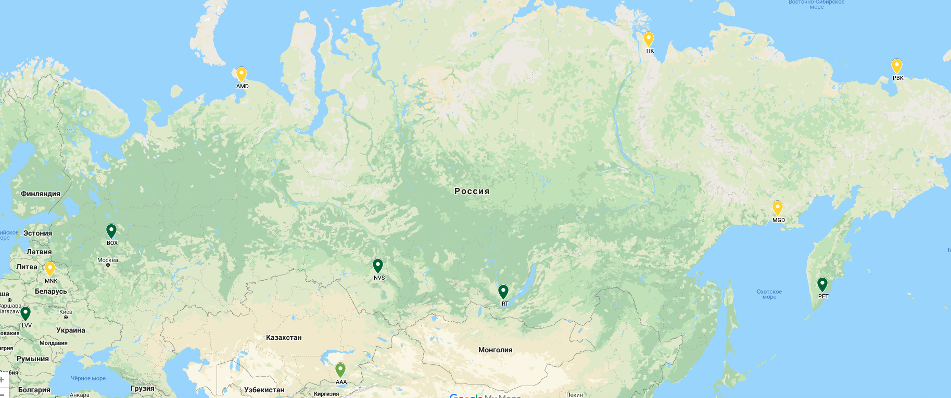
Geomagnetic observatories and stations

Slide 5
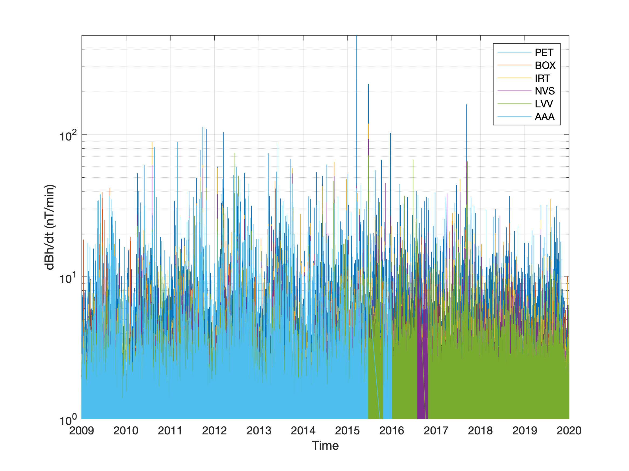
Distribution 1 min first differences in horizontal intensity
Data availability
Alma-Ata (AAA): 90.17 %
Borok (BOX): 97.85 %
Paratunka (PET): 99.45 %
Irkutsk (IRT): 99.98 %
Novosibirsk (NVS): 99.82 %
Lviv (LVV) : 96.47 %

Slide 6
Top disturbances in horizontal intensivity
BOX | NVS | IRT | PET | LVV | AAA*
589 nT/min, 17-Mar-2015 | 93 nT/min, 22-Jun-2015 | 120 nT/min, 22-Jun-2015 | 72 nT/min, 22-Jun-2015 | 74 nT/min, 16-Jun-2012 | 89 nT/min, 01-Mar-2011
226 nT/min, 22-Jun-2015 | 65 nT/min, 08-Sep-2017 | 89 nT/min, 04-Aug-2010 | 57 nT/min, 04-Aug-2010 | 71 nT/min, 22-Jun-2015 | 86 nT/min, 06-Jun-2013
136 nT/min, 08-Sep-2017 | 61 nT/min, 04-Aug-2010 | 64 nT/min, 12-Sep-2014 | 53 nT/min, 12-Sep-2014 | 67 nT/min, 23-Jun-2016 | 82 nT/min, 23-Aug-2010
113 nT/min, 26-Sep-2011 | 58 nT/min, 26-Sep-2011 | 61 nT/min, 26-Sep-2011 | 51 nT/min, 26-Sep-2011 | 65 nT/min, 14-Sep-2017 | 59 nT/min, 30-Jun-2012
109 nT/min, 25-Oct-2011 | 53 nT/min, 02-Oct-2013 | 59 nT/min, 24-Jan-2012 | 47 nT/min, 13-May-2013 | 47 nT/min, 14-Jul-2012 | 54 nT/min, 24-May-2013
*2009-2015

Slide 7
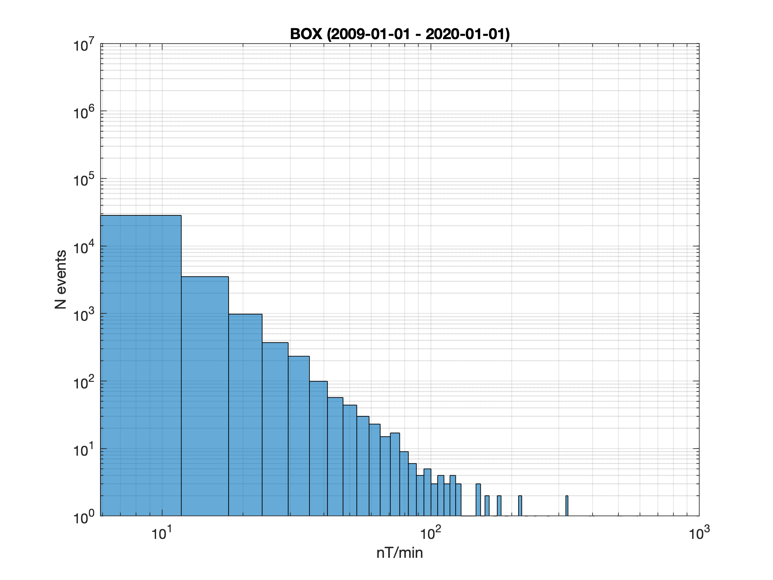
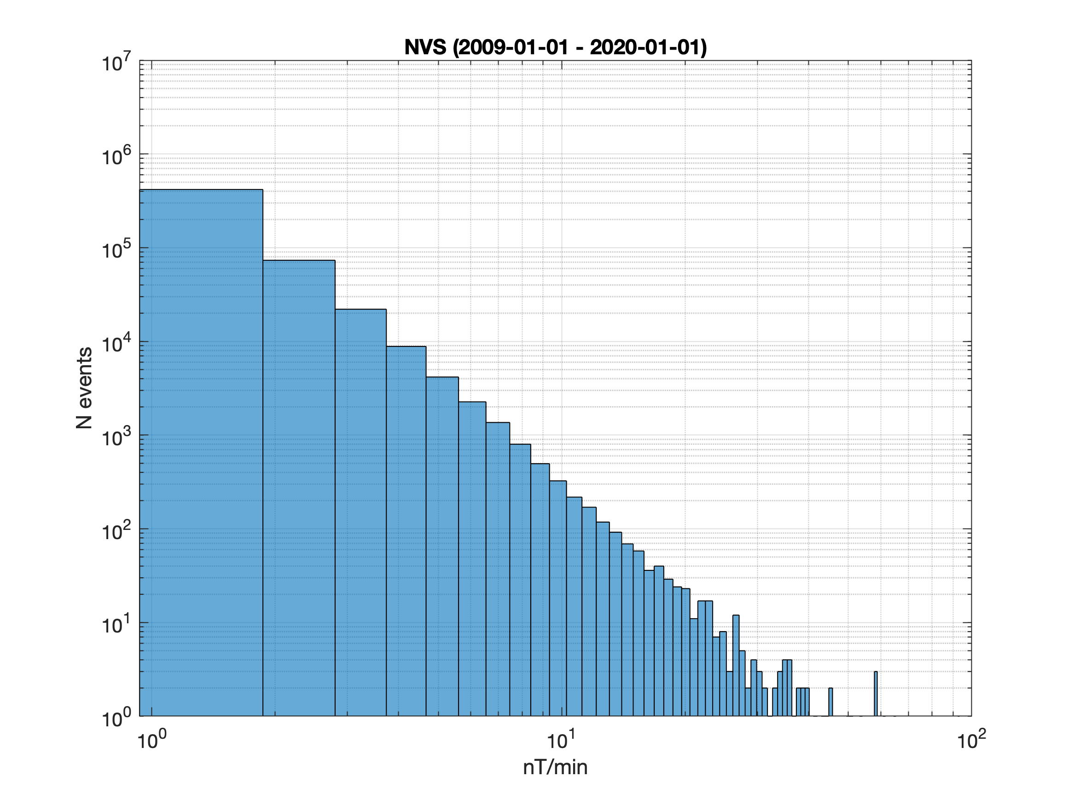
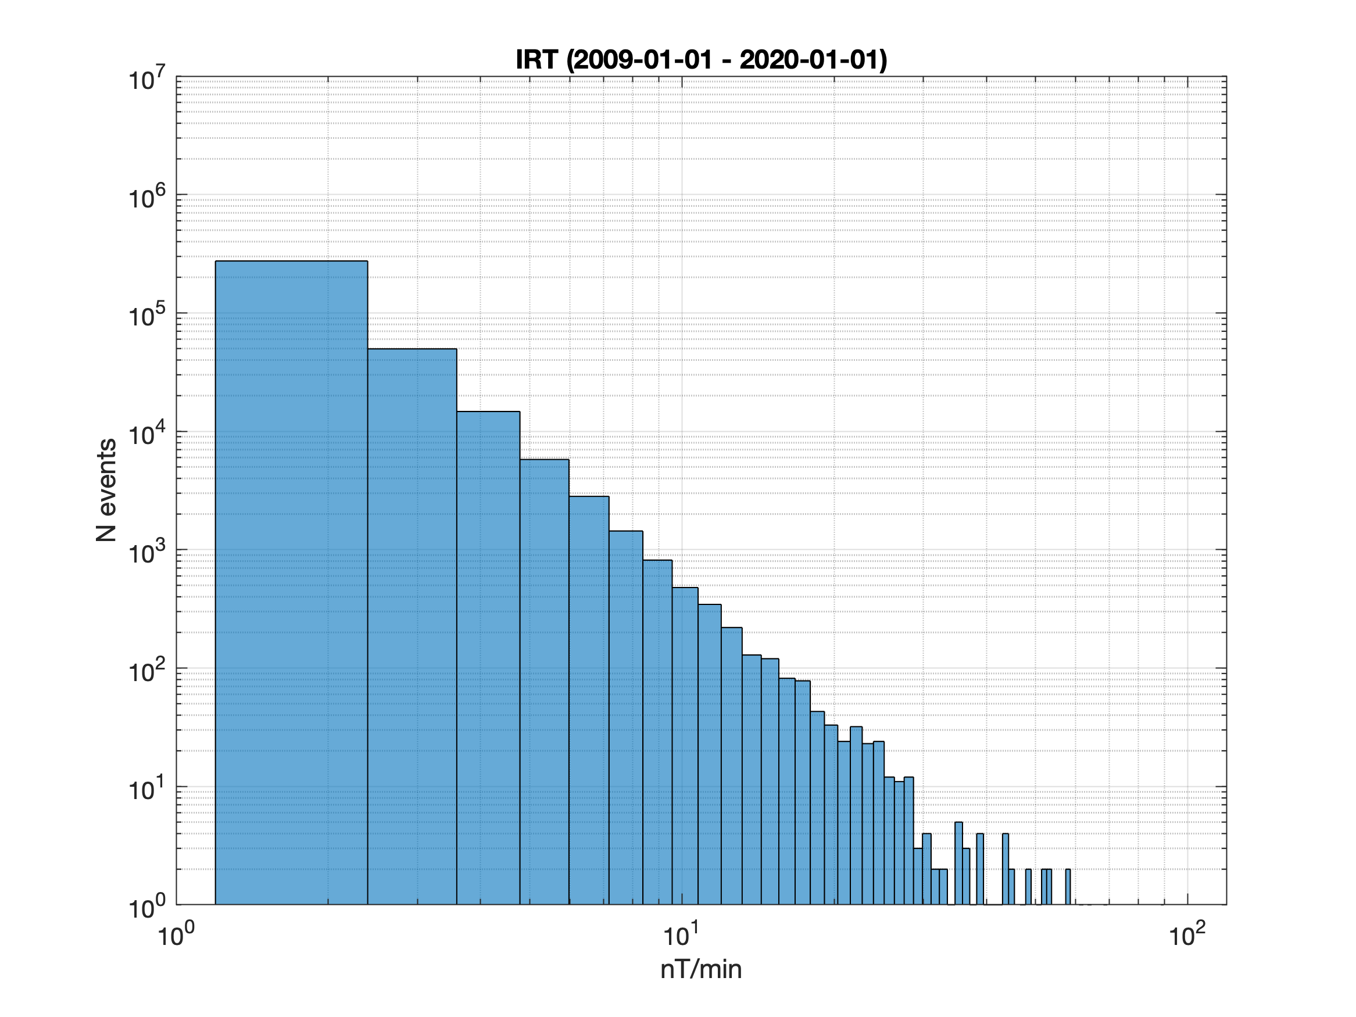
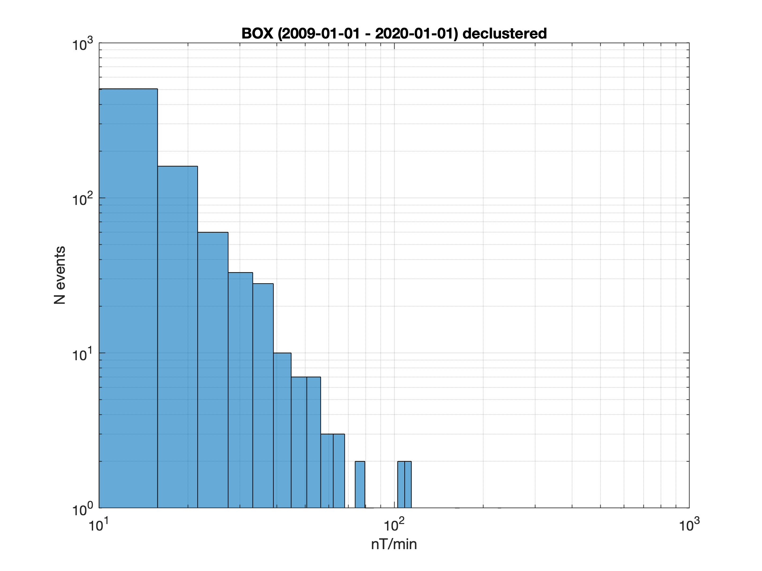
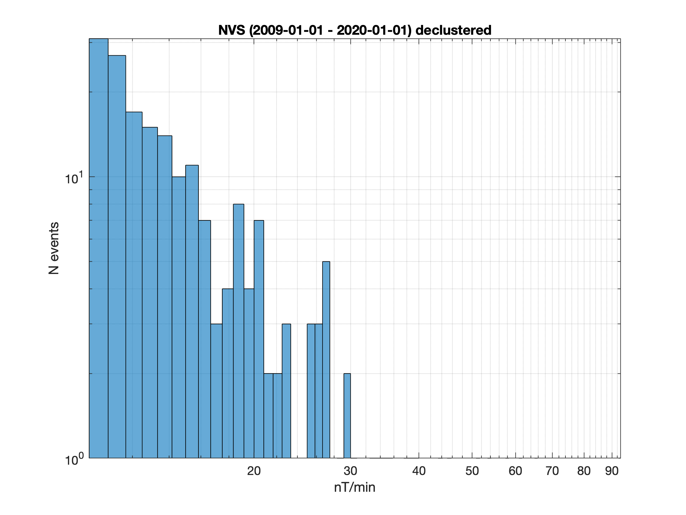
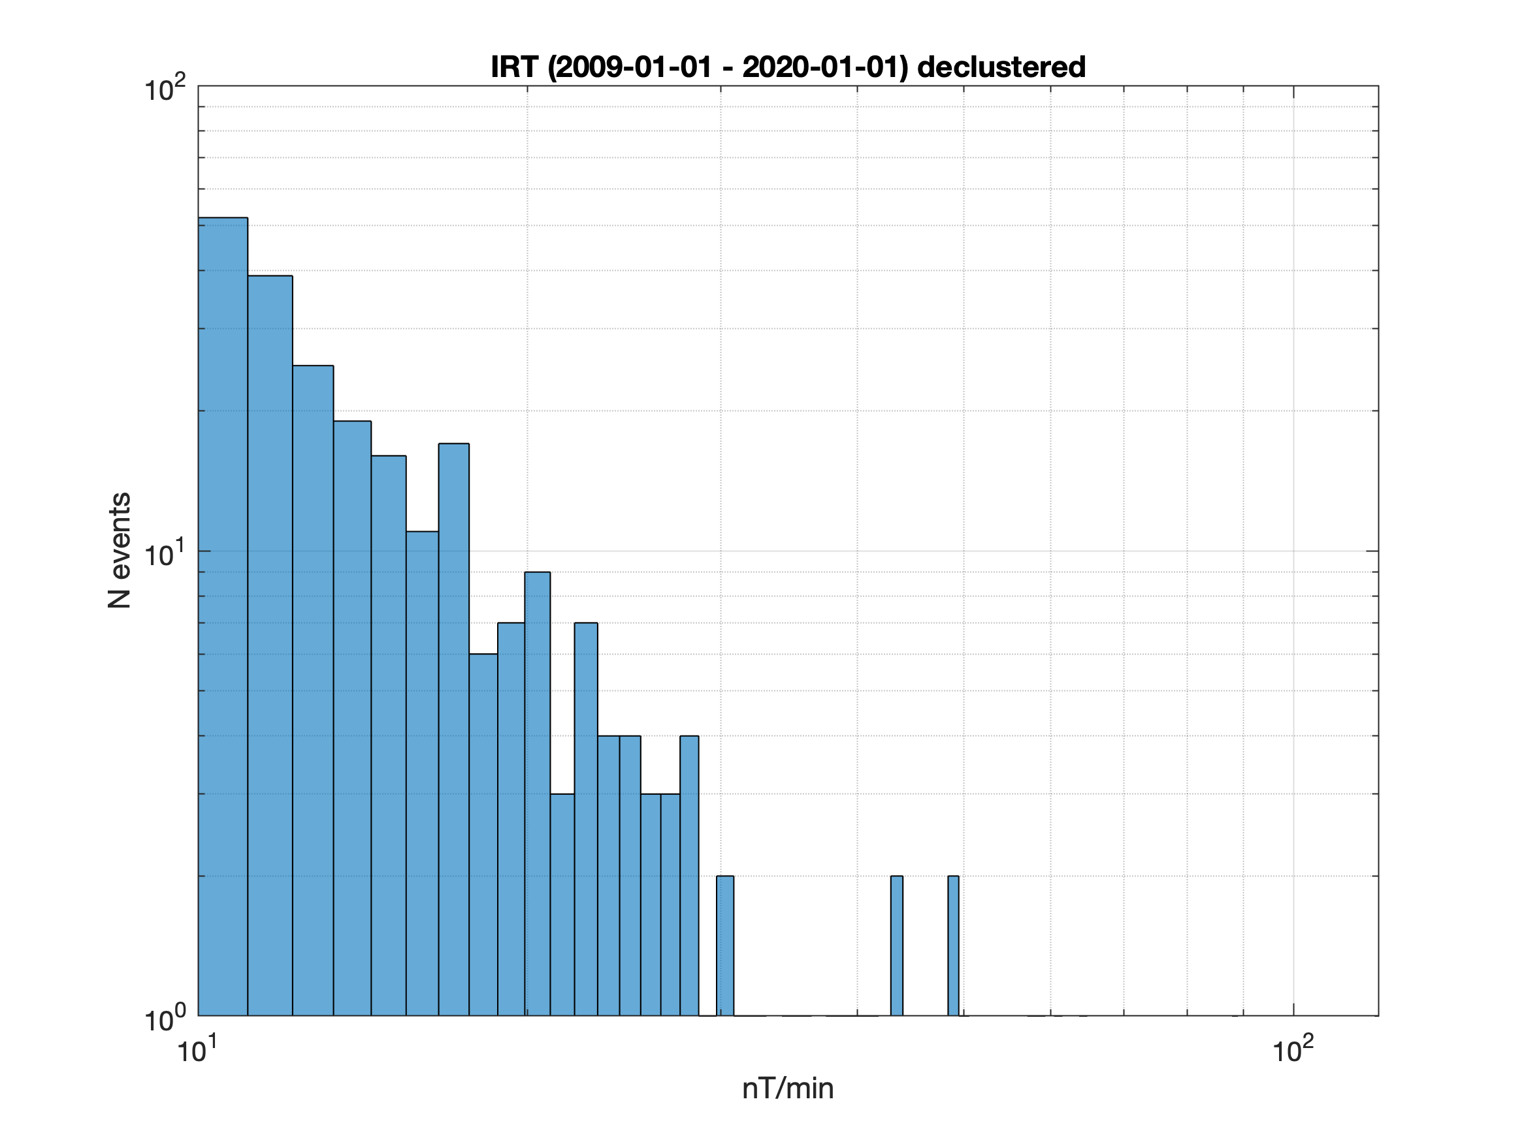
Raw and declustered activity data
BOX: 826 (8511) declustered events
NVS: 195 (1100) declustered events
IRT: 251 (1528) declustered events

Slide 8
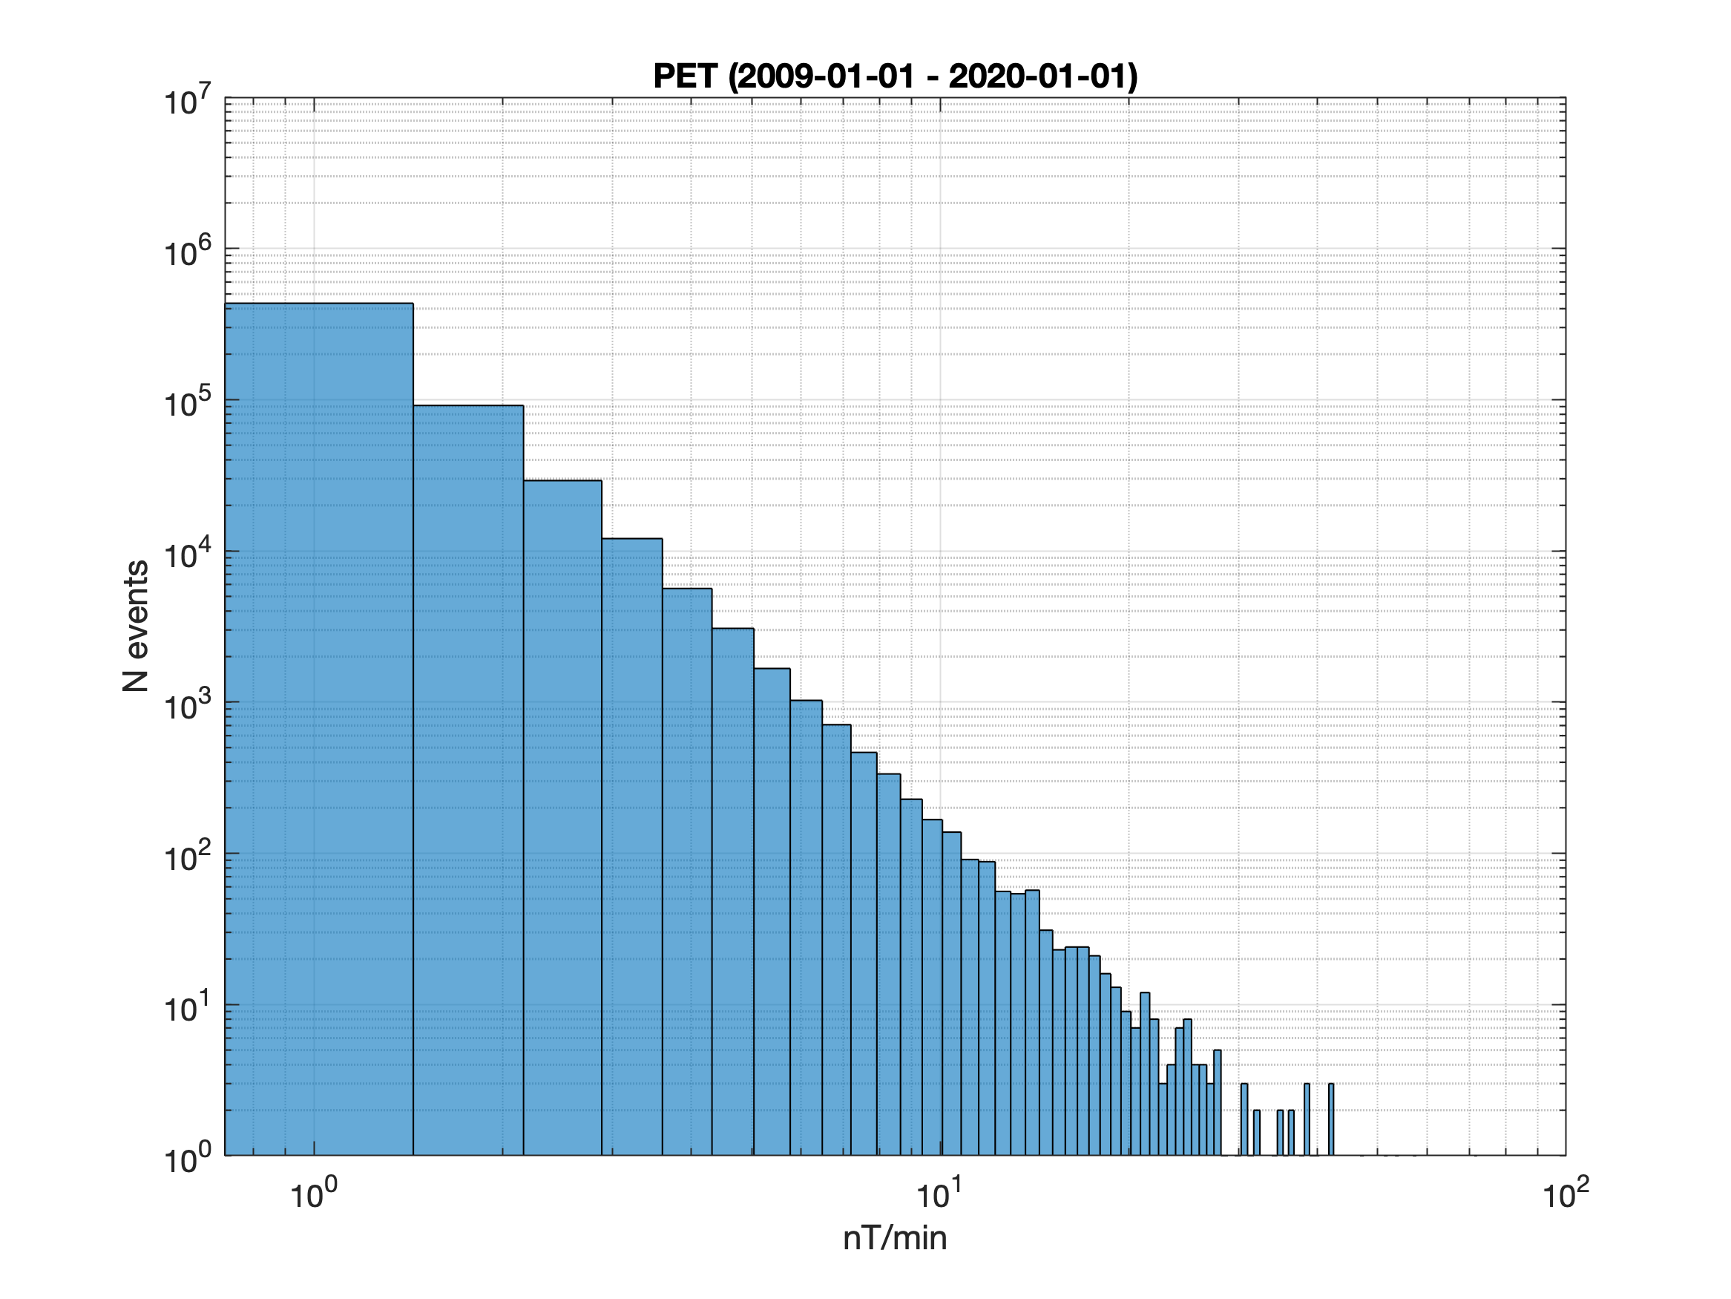
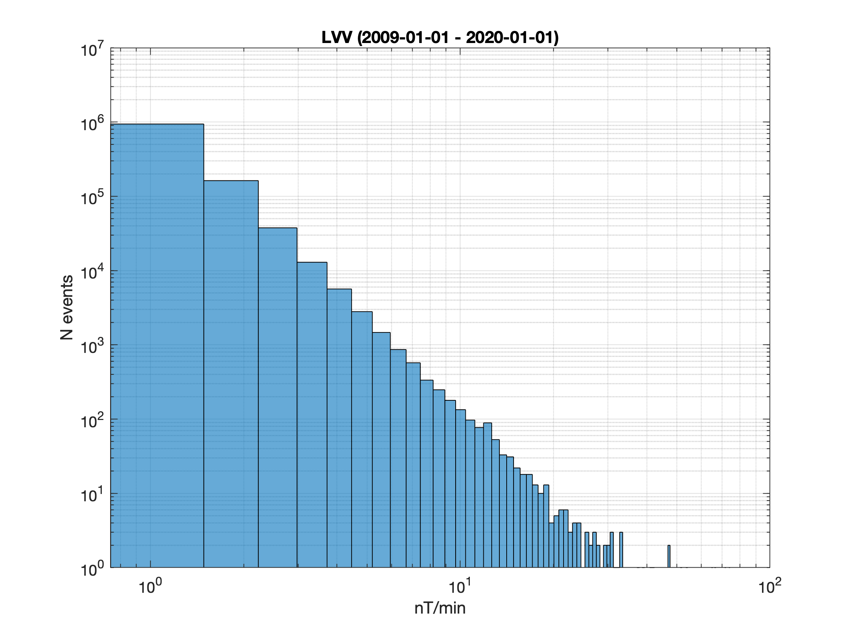
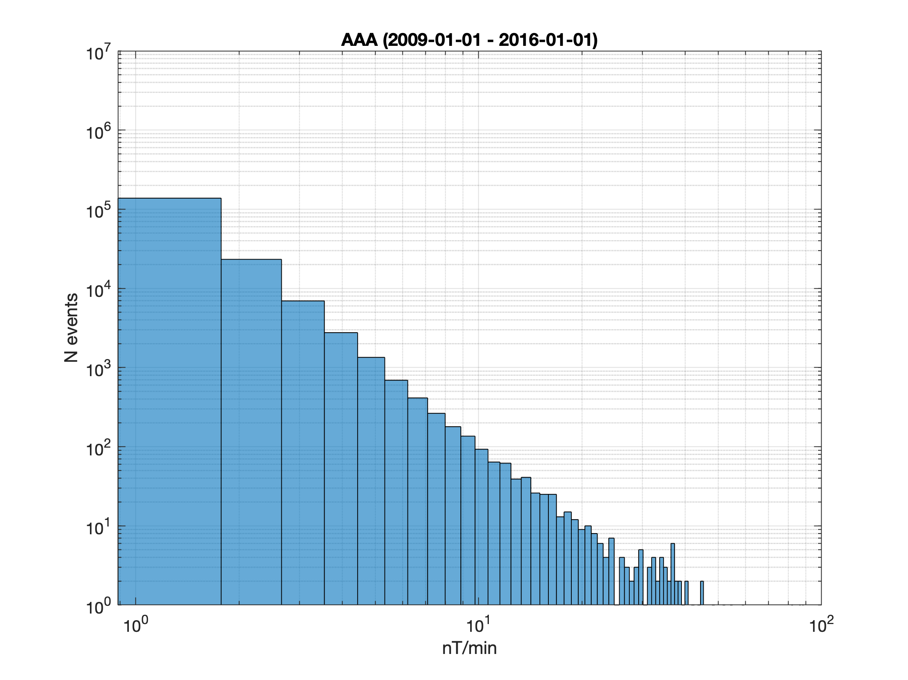
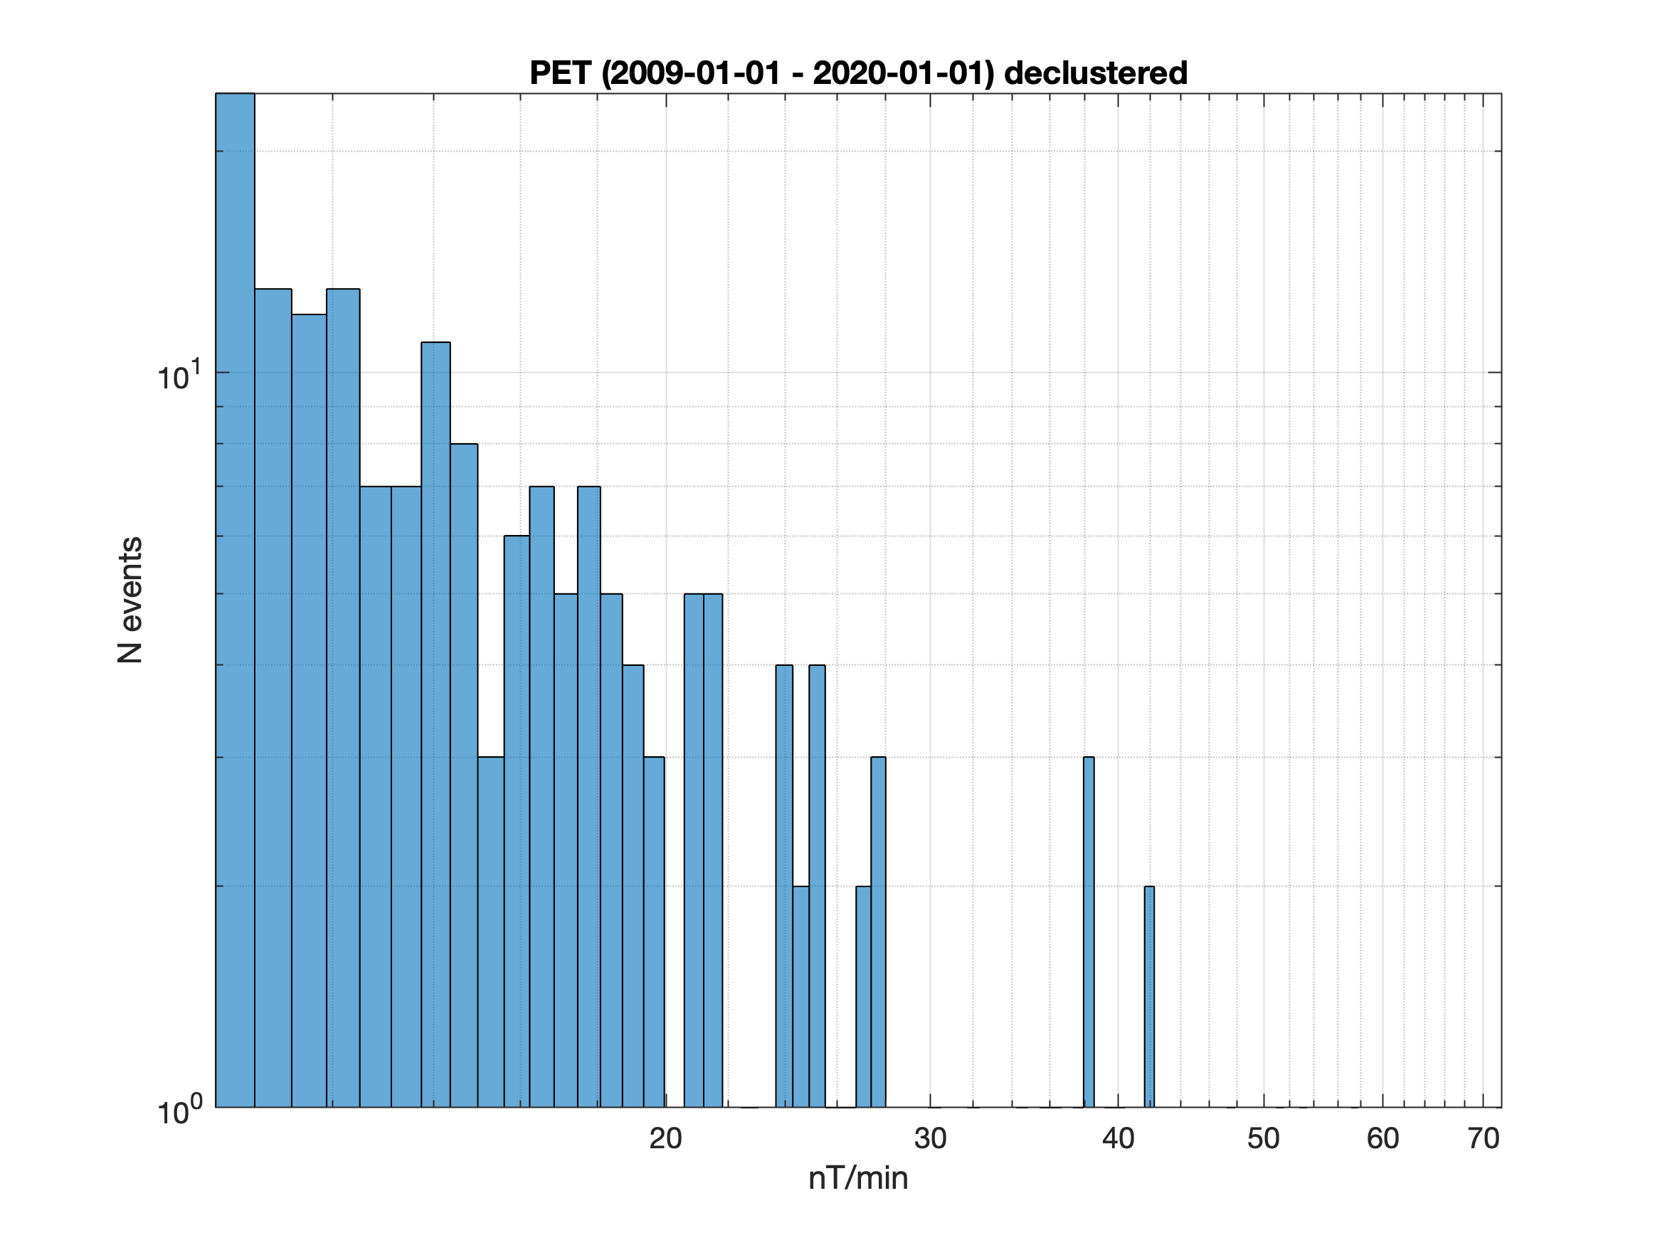
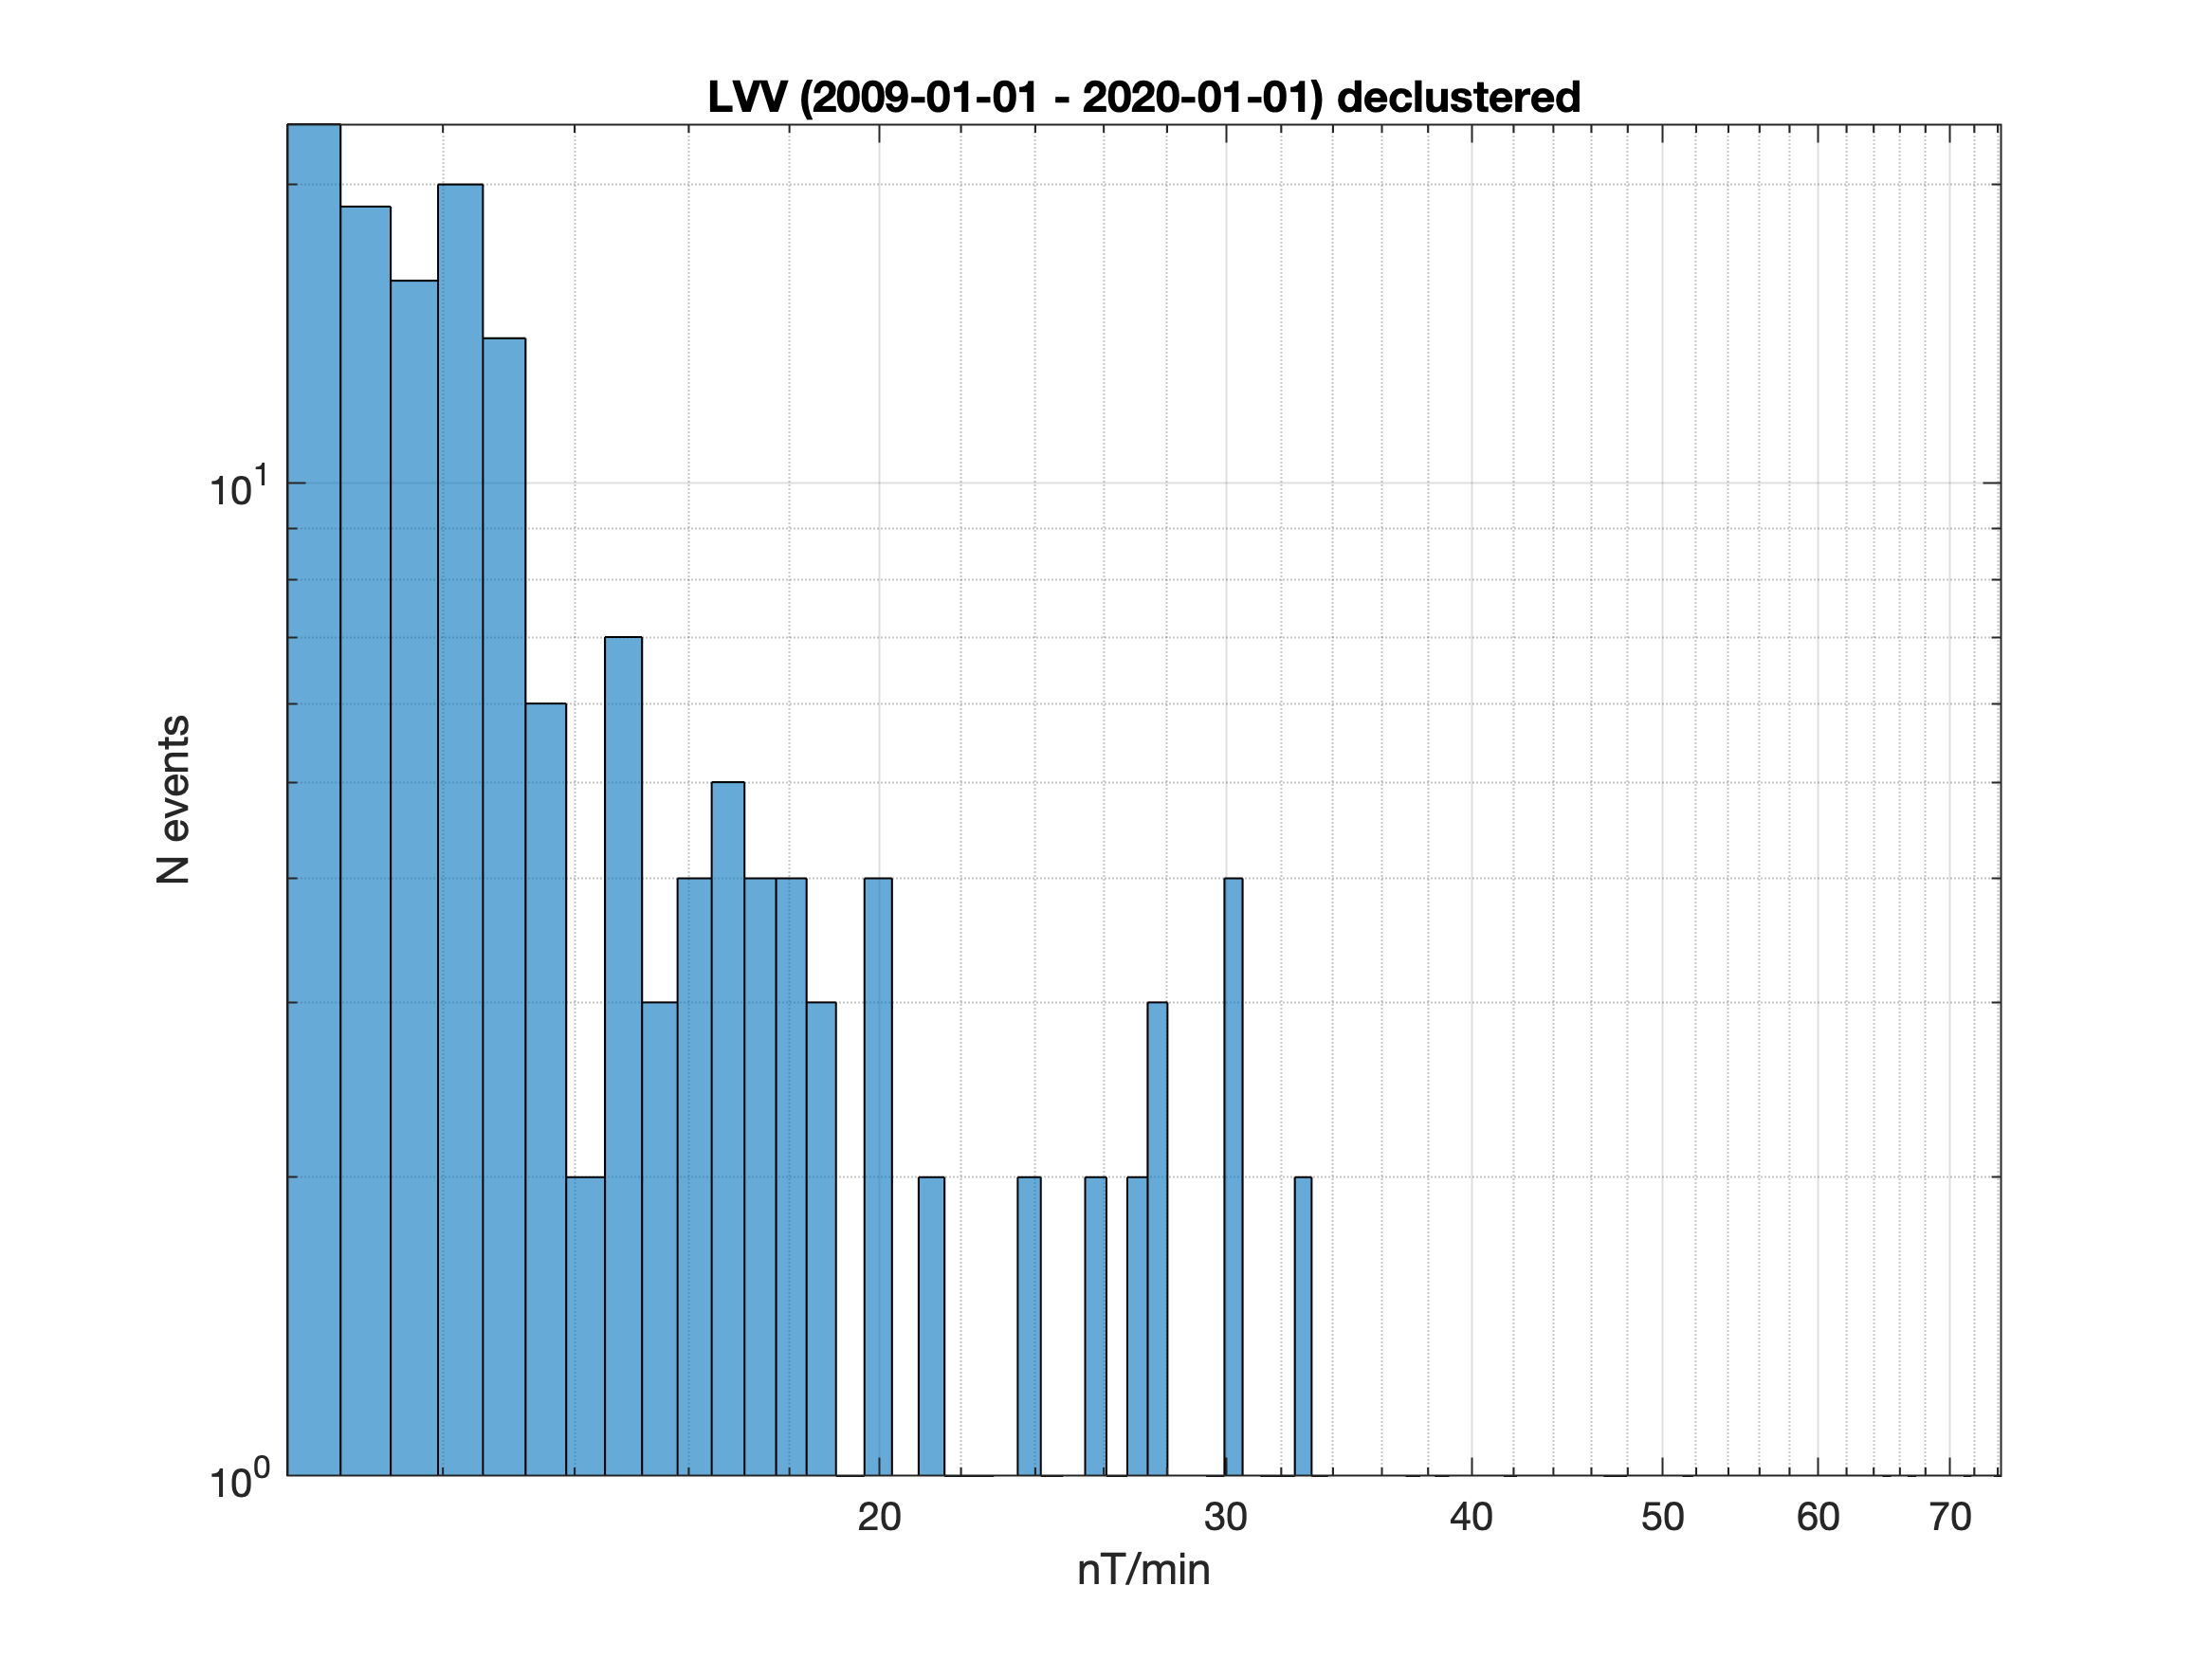
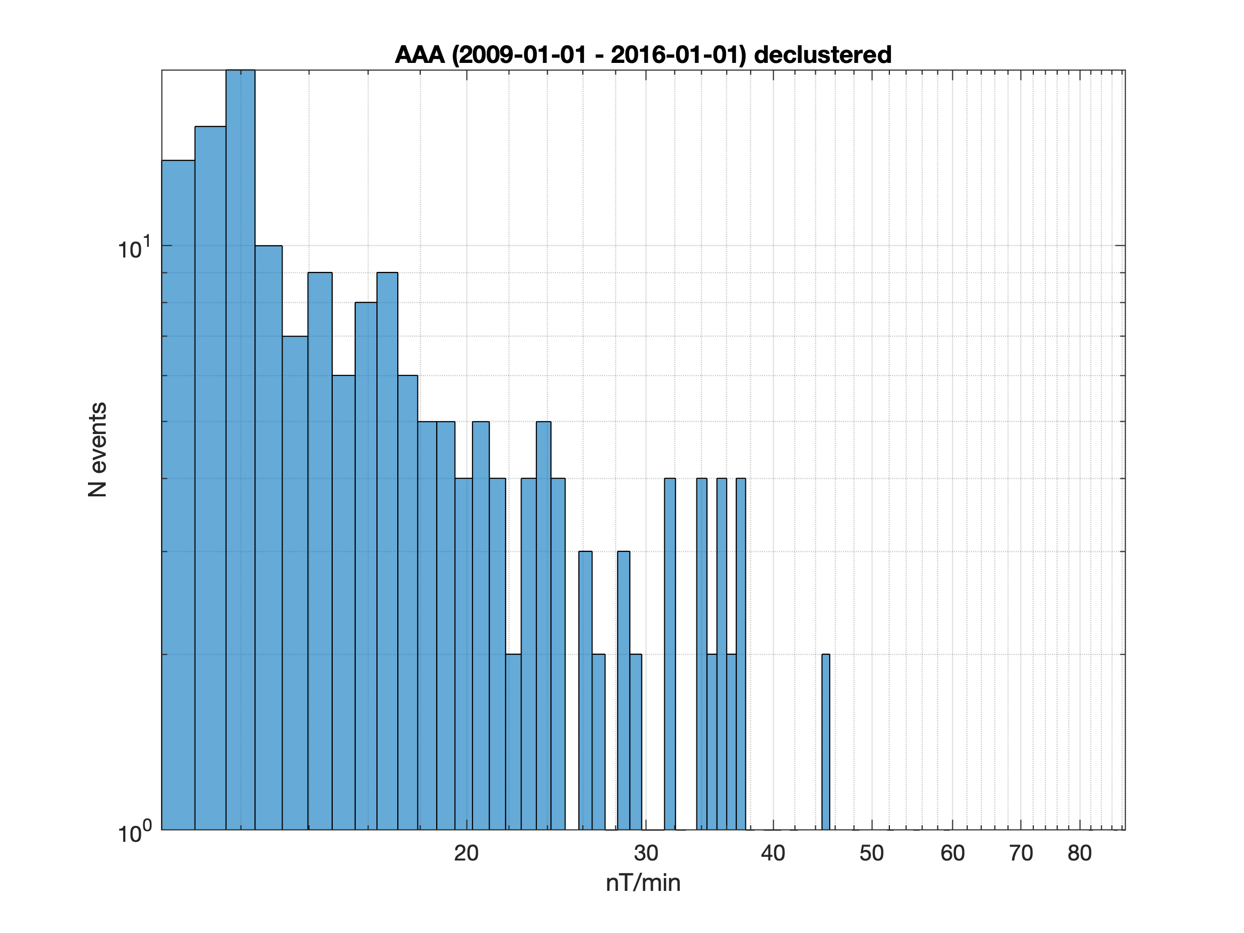
Raw and declustered activity data
BOX: 181 (754) declustered events
LVV: 170 (605) declustered events
AAA*: 190 (491) declustered events

Slide 9
Conclusions
Analyzed data of 6 observatories (AAA, BOX, IRT, LVV, NVS, PET)
1-min and 10-min rate of change activity highly sensitive on regional-scale situation
Derived declustered distribution of dB_{H}/dt can be used to estimate maximum disturbances more accurate

