Slide 1
2.33 - Semakov N.N.^{1,2*}, Kovalev A.A.¹, Pavlov A.F.^{1,2}, Fedotova O.I.¹
1 - Institute of Petroleum Geology and Geophysics SB RAS, Russia,
2 - Novosibirsk State University, Russia
Moving daily average of the hourly magnetic field values - the example of usage at Novosibirsk Observatory during 2011 (results and prospects)

Slide 2
Moving daily average of the hourly magnetic field values - the example of usage at Novosibirsk Observatory during 2011 (results and prospects)
Semakov N.N.^{1,2*}, Kovalev A.A.¹, Pavlov A.F.^{1,2}, Fedotova O.I.¹
1 - Institute of Petroleum Geology and Geophysics SB RAS, Russia,
2 - Novosibirsk State University, Russia

Slide 3
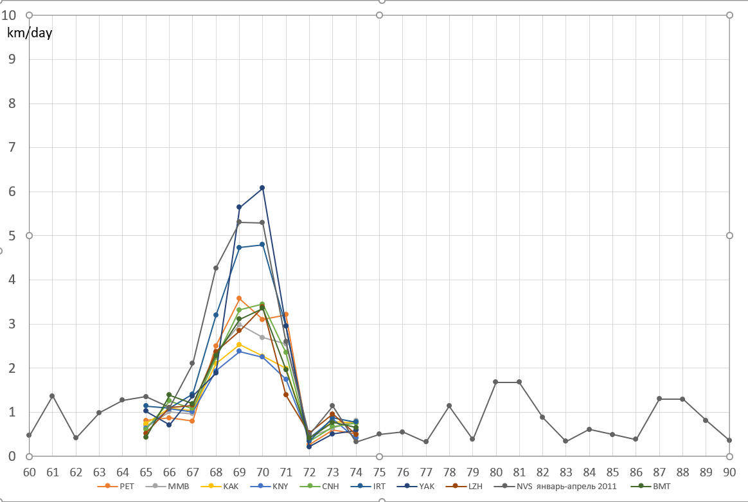
Average daily speed of virtual magnetic poles for magnetic observatories (01-31.03.2011)
11.03.2011
day

Slide 4
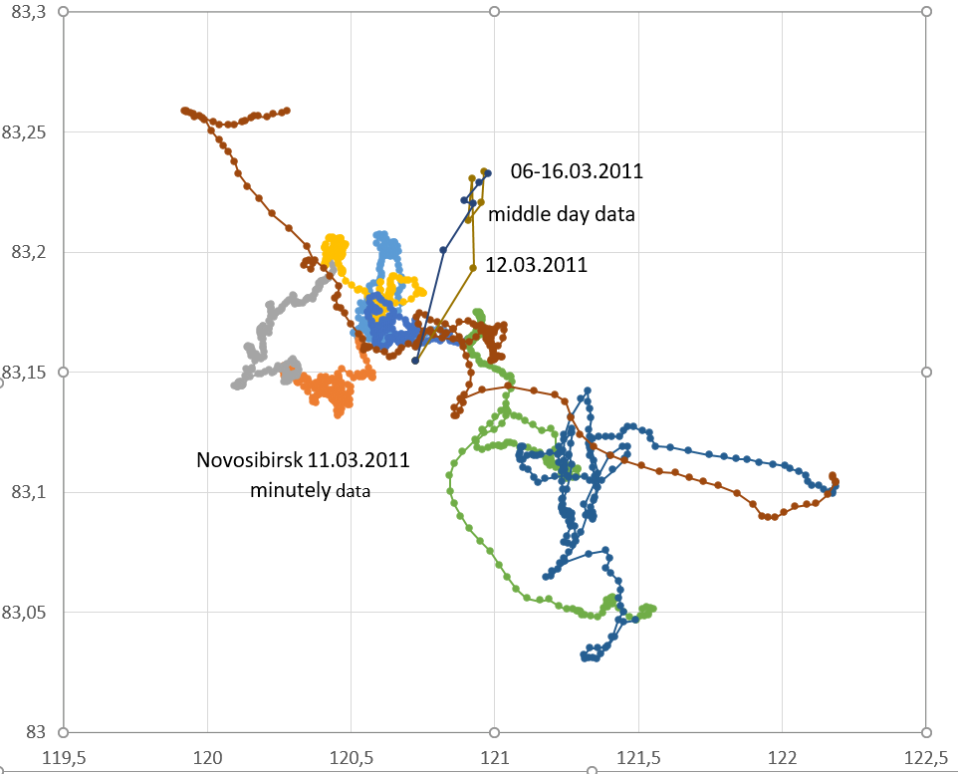
The movement of the magnetic pole on March 11, 2011 (by minute data) and from March 6 to March 16, 2011 (by average daily data) for the Observatory Novosibirsk

Slide 5
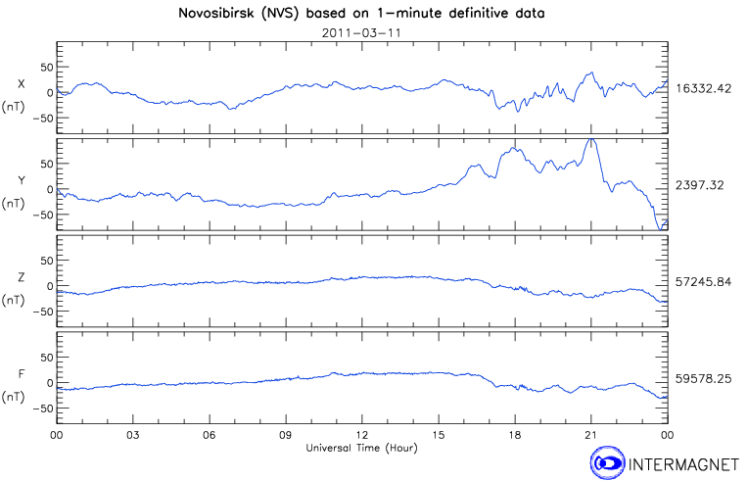
"Power" elements of terrestrial magnetism for 11.03.2011 at the Novosibirsk magnetic Observatory
05.46 UT

Slide 6
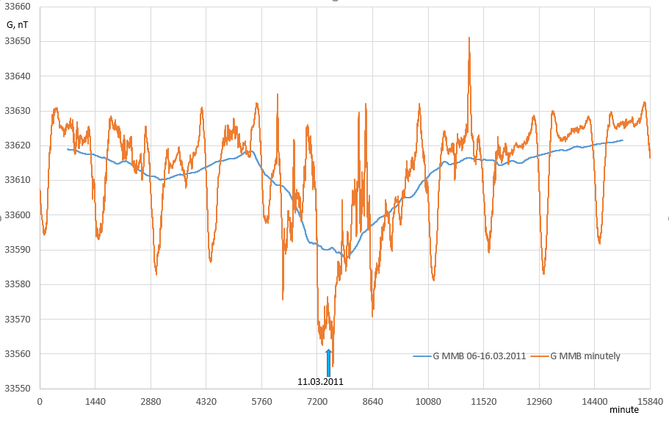
Minute data and average daily (24-hour) values of local magnetic constant (G) with a step of 1 minute (06-16.03.2011) calculated on the Memambetsu magnetic Observatory data

Slide 7
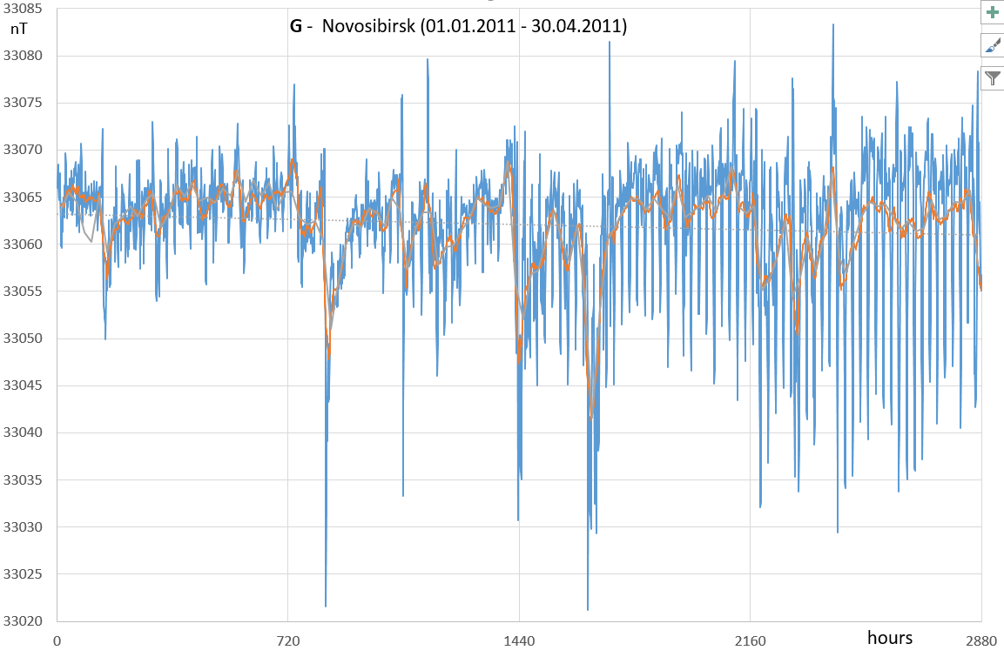
Average hourly and moving average daily values of local magnetic constant at the Novosibirsk Magnetic Observatory in January-March 2011
G=MR^3
G=(X^2+Y^2+0,25Z^2)^0,5
11.03.2011

Slide 8
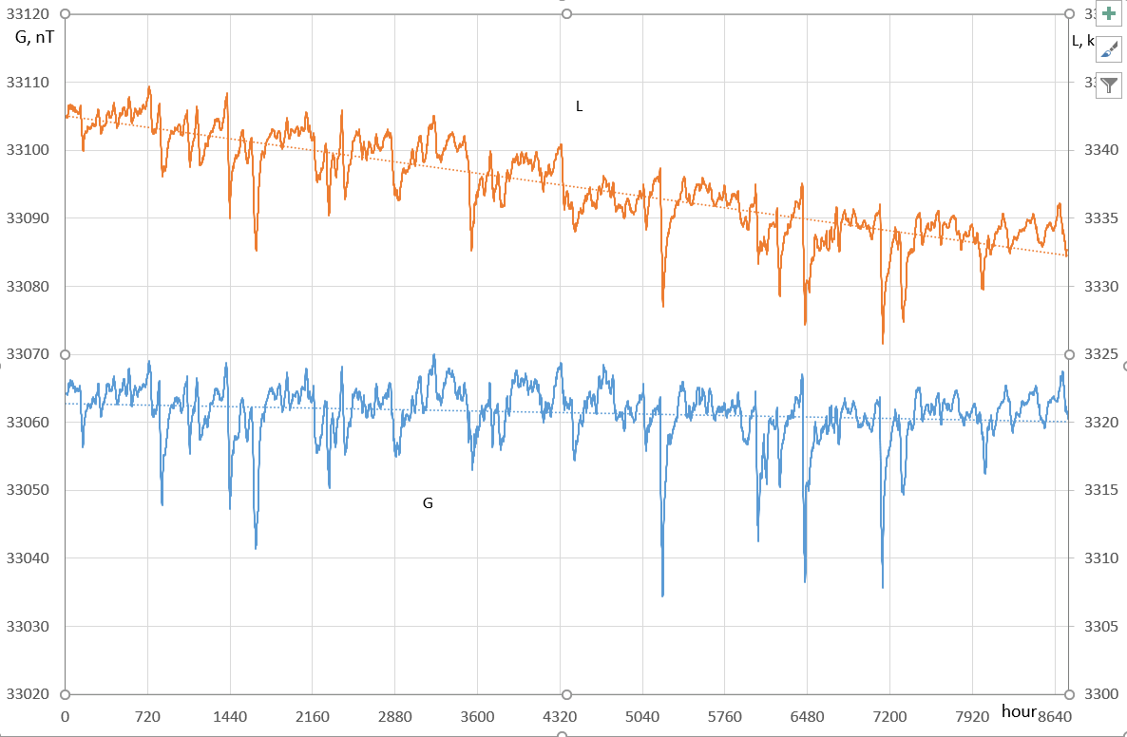
Moving average daily values of local magnetic constant (G, nT) and distance (L, km) from North magnetic pole for Novosibirsk Magnetic Observatory in January - December 2011
L, km
11.03.2011

Slide 9
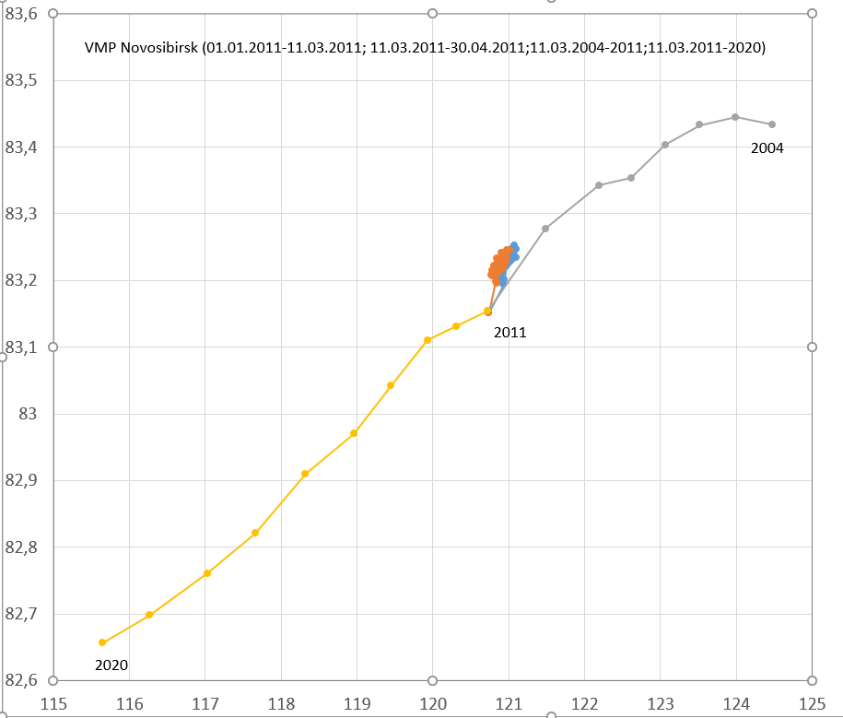
The movement of the magnetic pole 01.01-11.03.2011 and 11.03-30.04.2011 against the background of the curve of its annual movement according to the Novosibirsk Observatory

Slide 10
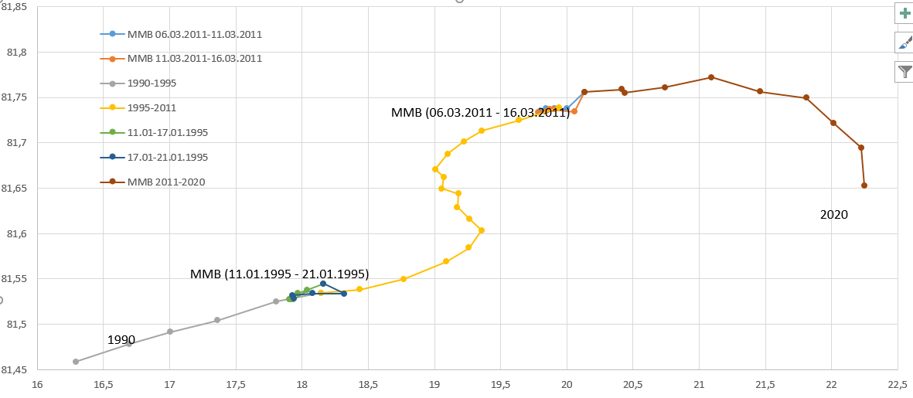
The movement of the magnetic pole from 6 to 16 March 2011 and from 11 to 21 January 1995 against the background of the curve of its annual movement according to the Memambetsu Observatory data

Slide 11
Conclusions
1. As possible geomagnetic harbingers of strong earthquakes it is advisable to consider integral power and angular characteristics of the magnetic field: the local magnetic constant and coordinates of virtual magnetic poles.
2. Most informative and optimal in practical terms are the "sliding" (in a step of 1 hour) average daily values of the above parameters.
3. The Great earthquake of Eastern Japan, which occurred at 6 o'clock world time on March 11, 2011, was preceded by a decrease in for several tens of hours of moving average daily values of local magnetic constant in all the nearest magnetic observatories of Japan, China and Siberia.
4. The average daily speeds of virtual magnetic poles increase significantly a few tens of hours before a major earthquake and fall to their previous values in about the same time.
5. In order to monitor possible geomagnetic harbingers of large earthquakes, continuous monitoring of moving averages of local magnetic constant and real-time coordinates of virtual magnetic poles is necessary.

Slide 12
Выводы
1. В качестве геомагнитных предвестников крупных землетрясений следует обратить внимание на такие интегральные силовые и угловые характеристики магнитного поля как локальная магнитная постоянная и координаты расчетных магнитных полюсов.
2. Наиболее информативным и оптимальным в прогнозном смысле представляется анализ скользящих суточных значений этих параметров
3. Великому землетрясению Восточной Японии предшествовало постепенное уменьшение локальной магнитной постоянной в течение нескольких десятков часов во всех ближайших обсерваториях Японии, Сибири и Восточного Китая.
4. В этот же период происходил существенный рост скорости перемещения расчетных магнитных полюсов и последующее ее снижение.
5. Для изучения и использования возможных геомагнитных предвестников крупных землетрясений нужно вычислять и отслеживать в минутном режиме реального времени скользящие суточные значения локальной магнитной постоянной и координат магнитных полюсов.

Slide 13
All authors thanks employees of magnetic observatories whose data used to calculate the geographic coordinates of magnetic poles and the value of local magnetic constant.
Thank your for attention!

