Slide 1
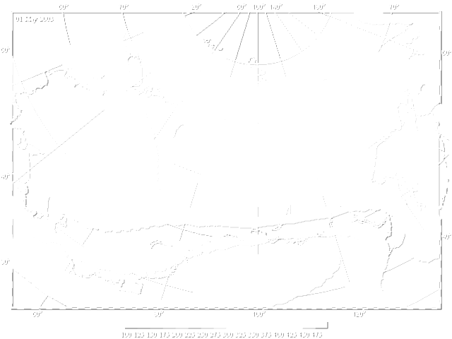
Daily variations of the refractive index in the south of the Vitim plateau in different seasons of the year
Institute of physical materials science SB RAS
Russia, Ulan-Ude, Sakhyanovoy, 6
Bazarova A.S.
Atutov E.B.
Bazarov A.V.
Bashkuev Yu

Slide 2
Urgency of the problem
The urgency of the problem of studying the refractive properties of the troposphere is predetermined by the increasing rate of use of radio meteorological parameters in the design and operation of GLONASS-GPS and GSM radio-electronic systems in various physical and climatic regions of the Earth, in particular in eastern Russia. Specialists are faced with an urgent need to study the laws governing the propagation of VHF-UHF radio waves taking into account the influence of all layers of the atmosphere as a medium with a variable refractive index.
The report presents the calculation of the refractive index N based on meteorological data of the atmospheric-soil measuring complex ASMC, located on the basis of the measuring hospital in s. Sosnovo-Ozerskoye, Eravninsky district of the Republic of Buryatia. The dependences of the refractive index on atmospheric pressure, water vapor elasticity, and absolute air temperature are established.

Slide 3

Refractive index
$N=\left(n−1\right)×{10}^{6}=\frac{77,6}{T}×(P+\frac{4810e}{T})$,
P - atmospheric pressure, mbar;
e - water vapor pressure, mbar;
T - the absolute air temperature, K.
For the commonly occurring values of P, T and e, formula (1) is considered accurate within 0.5% over the entire radio wave range at λ≥1.3 cm.

Slide 4
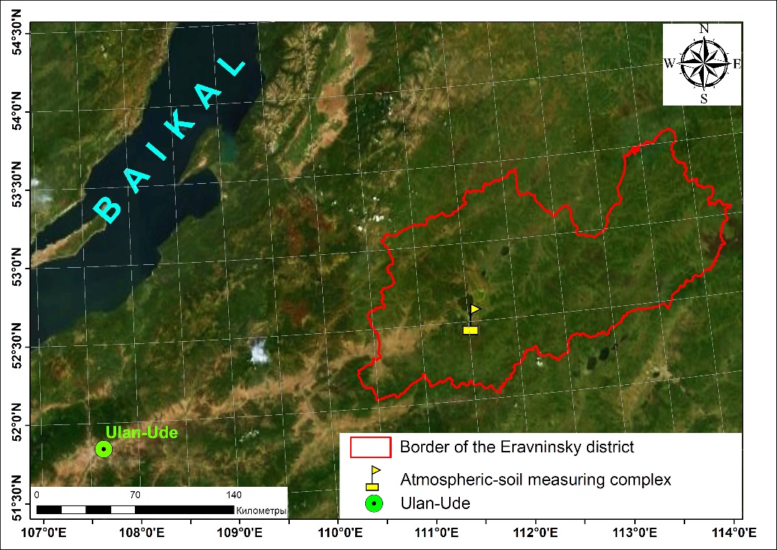
Measurement point location of the Eravninsky district territory

Slide 5
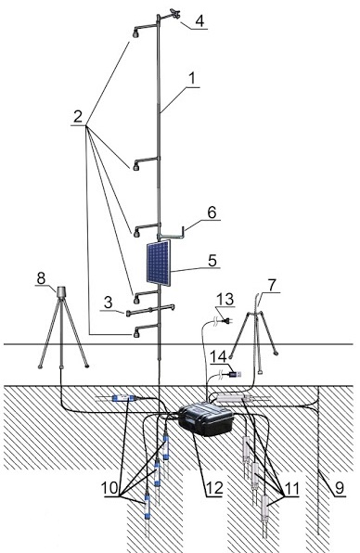
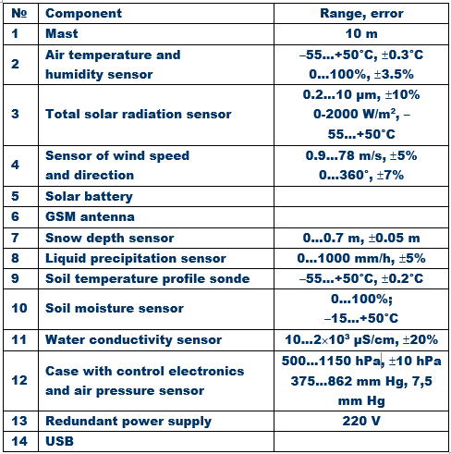
ASMC scheme. The numbering of components in the table coincides with the designations on the scheme

Slide 6
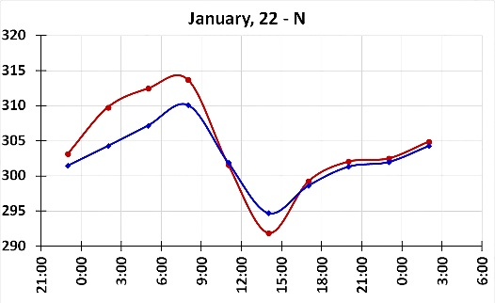
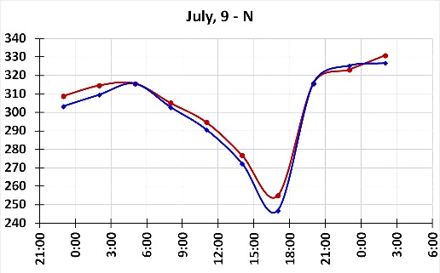
Refractive index variations
a) January, 22 2016
b) June, 9 2016

Slide 7
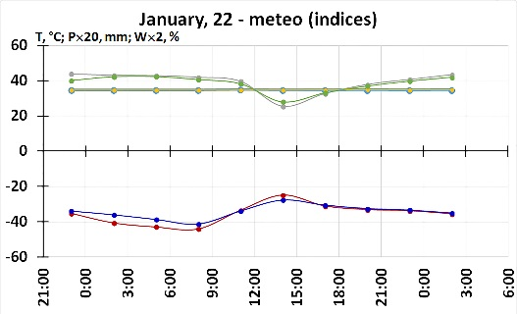
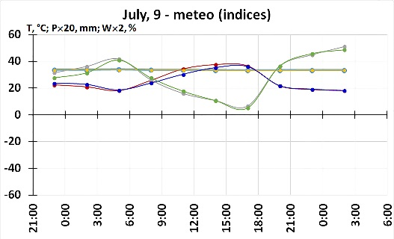
Temperature, air humidity and atmospheric pressure variations
a) January, 22 2016
b) June, 9 2016

Slide 8
The results of our measurements coincide with the conclusions of N.Ts. Gomoboev and Ch.Ts. Tsydypov, who conducted a study of the value of the refractive index of air near the Earth's surface in Transbaikalia based on the materials of three ground stations of the hydrometeorological service network for 5 years (1958-1962). The stations were located in different physical and geographical conditions: Ulan-Ude and Barguzin - far from large bodies of water, Ust-Barguzin - on the shore of the lake. Baikal:
Daily changes in N mainly depend on humidity and air temperature, since the pressure changes insignificantly during the day.
According to the results of calculations of the daily rate N is simple with one maximum and one minimum. In winter and autumn, everywhere the maximum occurs in the morning hours (6 or 7), in spring and summer at some points - at 1 am, and at others - at 6 or 7 am. The minimum is observed everywhere and in all seasons in the afternoon (13-15 hours).
According to the amplitudes of daily changes in N, calculated from long-term data, it can be seen that the largest amplitudes occur in summer, and the smallest ones - in winter.

Slide 9
Results
The refractive index N in the surface layer of the atmosphere has pronounced daily fluctuations
The diurnal variations of the refractive index N in the south of the Vitim plateau are determined to a greater extent by variations in air temperature and humidity than by atmospheric pressure.
In the daytime, an inversion of N with altitude is observed in the absence of atmospheric turbulence.

Slide 10
The work was carried out within the framework of the budget project 0336-2019-0006 “Propagation of radio waves in inhomogeneous impedance channels”.

Slide 11
Thanks for your attentions!

