Slide 1
Charge Density Distribution Model in Self-Organizing Cloud
Institute of Applied Mathematics and Automation KBSC RAS
Tembulat Kumykov

Slide 2
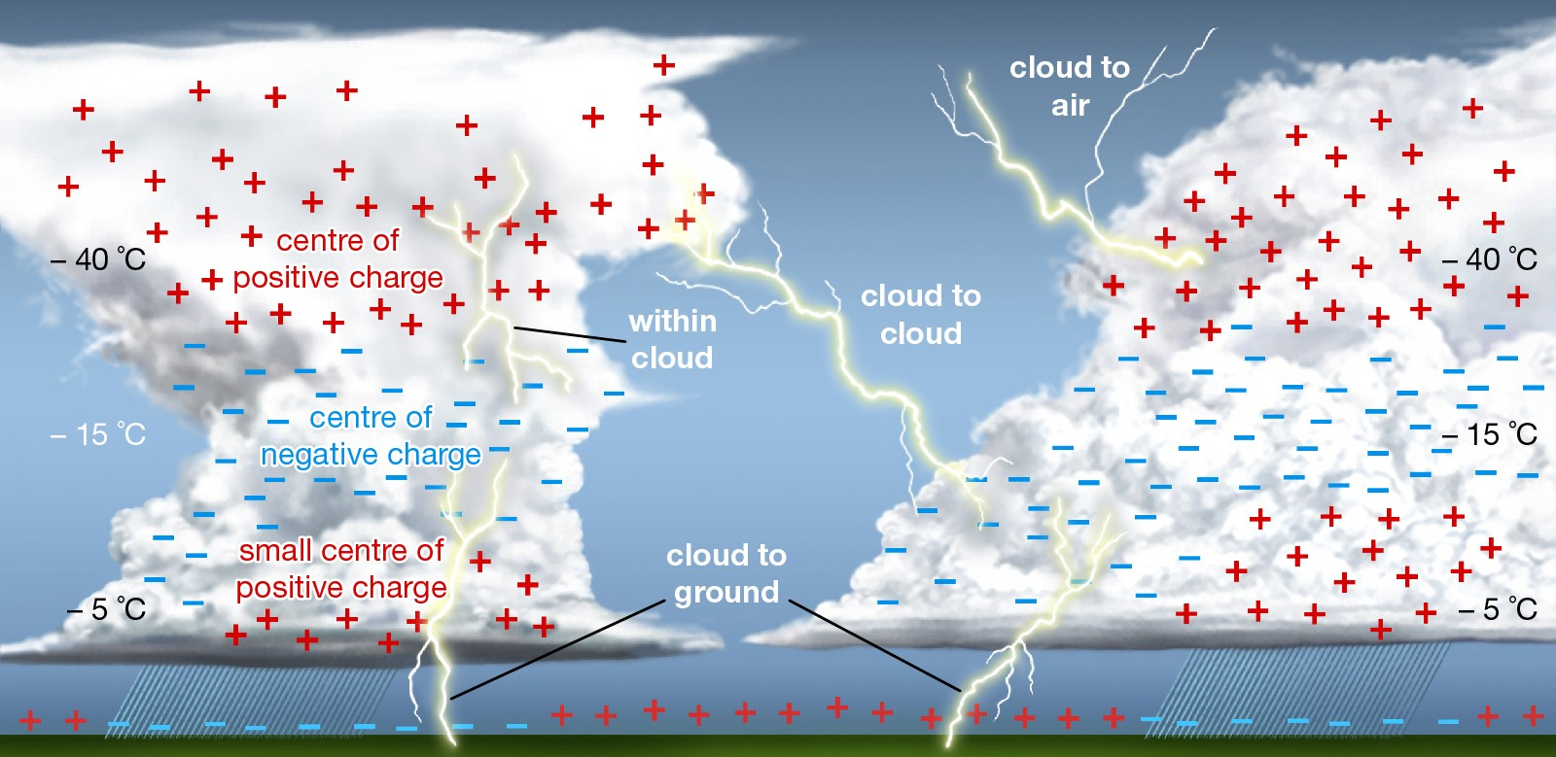

Slide 8
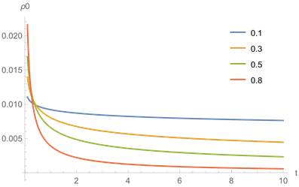

Slide 9
THANK YOU FOR YOUR ATTENTION

